Slide 1
Components and Templating
Spencer Schneidenbach

Slide 2
Components, components, components…
Components in Angular 2 are awesome
Composable and easy to maintain
Lots of smaller components > Fewer big components
Follow the Web Component ideal
Abstracting a large chunk of HTML into a single element
“Building blocks”
Functionality is fully encapsulated – expose only what needs exposing

Slide 3
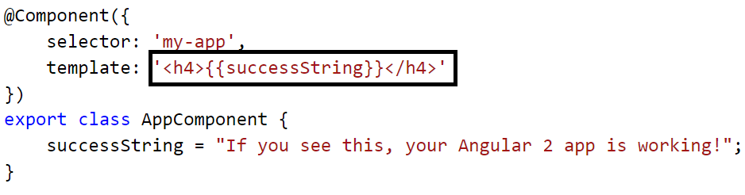
Intro to Templates
Templates contain the HTML that is rendered by your component
Can be placed inline inside of Component declaration OR in a separate file

Slide 4
Ways to bind component to view
Interpolation expressions
Property binding
Event binding
ngModel

Slide 5
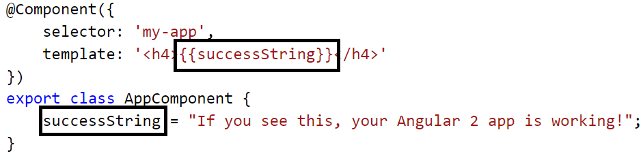
Interpolated expressions
{{ }} syntax
Put your expression inside the brackets
Accepts non-side-effect-JavaScript (no new, assignments, etc.)
Best use case – bind pure properties to it when possible

Slide 6
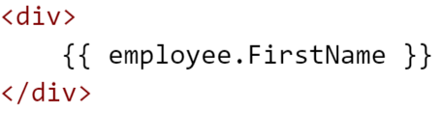
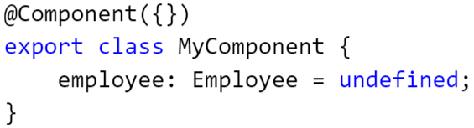
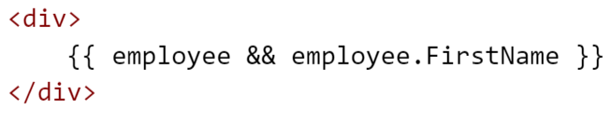
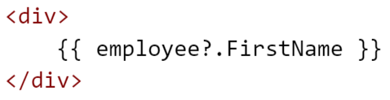
Interpolated expressions, cont’d
What if you have something like this?
This will throw an error. And this sucks ->
Elvis to the rescue! (…I don’t know why they call it the Elvis operator. It’s called “monadic null checking”)

Slide 7
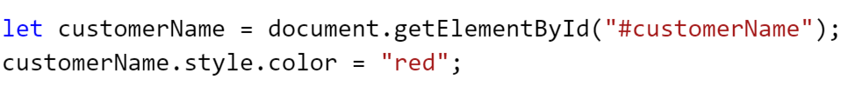
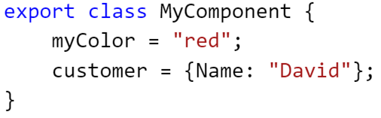
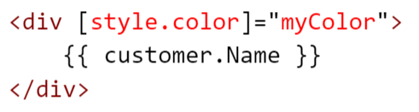
Property binding
Bind directly to properties on the DOM model using []
The power and convenience of this cannot be understated!
Allows something like this:
To become this:

Slide 8
Property binding, cont’d
You can also bind to attributes by using [attr.name]
Example: aria (accessibility) attributes don’t have DOM model property bindings

Slide 9
Property binding, cont’d
Property binding means that all sorts of previous built-in directives in Angular 1 go away
Demo
Ng1 Directive | Functionality | Replaced with
ng-disabled | Disables the control – used on inputs, selects, textareas | [disabled]=“expression”
ng-src/ng-href | Replacement for src/href properties since interpolation didn’t play well with them | [src]=“expression” [href]=“expression”
ng-show/ng-hidden | Hides/shows an element based on the truthiness of an expression | [hidden]=“expression”
Notes:
Show hidden, style.color, style.width

Slide 10
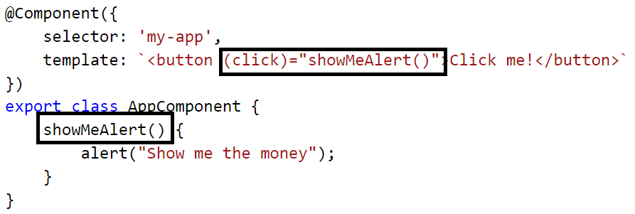
Event binding
Bind directly to events on the DOM model using ()
Again, the power and convenience cannot be understated
Support for custom events

Slide 11
Event binding, cont’d
Event binding means that all sorts of previous built-in directives in Angular 1 go away
Ng1 directive | Functionality | Replaced with
ng-click | Binds an expression to the click event | (click)=“doSomething()”
ng-change | Binds an expression to the input changed event | (change)=“prop = $event” (ngModelChange)=“”
ng-dblclick | Binds an expression to the double click event | (dblclick)=“onDoubleClick()”
ng-mouseover | …mouse over event
ng-mousemove | …mouse move event
…you get the idea

Slide 12
ngModel
Allows two-way binding
Follows unidirectional data flow concepts
Demo
Notes:
[value] is property
(input)=“thing = $event.target.value”

Slide 13
Two essential directives
*ngIf
Optionally renders an element based on the truthiness of an expression
Demo
*ngFor
Looping directive
Replaces ng-repeat from Angular 1
Demo

